Slide 1
A Rayford Quantitative Methods
UPEP 802
Quantitative Methods in Planning
November10, 2016

Slide 2
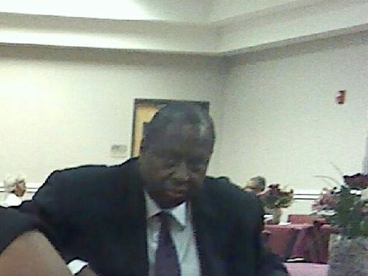
Inferential Statistics
Population-larger group or subject to be measured (functional N-size)
Sample-smaller group or subset to be measured (conclusions n=size)

Slide 3
Variables/Domain
Competencies/Standards:
communication social economic dependent culture
learn discuss read write relationship Career
friends Business Entrepreneurship death parenting
Gift process promise grandbabies assessment training
life vision {EDUCATION} planning
Family dynamics objectives
measurement community
variables- MATHEMATICS a quantity that during a calculation is assumed to vary or be capable of varying in value.
COMPUTING a data item that may take on more than one value during the runtime of a program.

Slide 4
Domain/sublets
Competencies/Standards:
{Industry} love political Integrity
learning differences nurture appreciation awareness
design promote educator change sustainability
protect learning opportunities

Slide 5
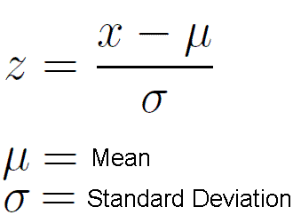
Z test sample and population
examine the differences between variables
1 sample n=size and a population N-size
one-sample Z-test (sample means (X) belong or represents a population mean (µ)
∂=ó/√n SEM- standard error of mean ∂ standard deviation for the population and
n=size

Slide 6
Examine and dealing with Variables
relationships between 2 or more
variables
EDUCATION Career
t-test significance of correlation coefficient
rxy= n∑xy-∑x∑y /√ [n∑x2-(∑x)2] [n∑y2-(∑y)2]
Statistics for People Who Hate Statistics page 131

Slide 7
Examine and Dealing with variables
more than 2
planning measurement assessment economic
{Industry}
design [educator] promote change
motivation sustainability
Regression Factor Analysis

Slide 8
T test Dependent samples
difference between groups of variables same participants tested more than once
Population YES Samples
How many? 2 groups
T test Dependent samples

Slide 9
T-test dependent samples
comparison of means from each group and focus on differences between scores
T=∑D
√ n∑D2- (∑D)2
n-1 (degree of freedom)
score-to estimate population parameters when the sample size is
small and/or when the population variance is unknown.
Statistics for People who Hate Statistics page 273

Slide 10
Measure Analysis of Variance
YES same participants being tested MORE than two groups
measure analysis of variance
Population Samples

Slide 11
T Test Independent samples
differences between groups of variables same participants tested (NO)
2 groups T test Independent samples
Population Samples Population Samples

Slide 12
T test independent samples
A t-test helps you compare whether two groups have different average values (for example, whether men and women have different average heights). The “One Sample T-Test” is similar to the “Independent Samples T-Test” except it is used to compare one group’s average value to a single number.
t= x1-x2/√[(n1-1)s2/1+(n2-1)s2/2]/n1+n2-2{n1+n2/n1n2}
*Statistics for People Who Hate Statistics page 254

Slide 13
Simple Analysis of Variance (ANOVA)
differences between groups same participants tested (NO)
MORE than 2 groups How many factors? 1
Simple Analysis of Variance (ANOVA)
Similar to a T test but the differences between means (average score divided by # of observations) are computed and there are more than one means (Standard deviation).
Educator-CTE HS Educator-Pre-K Charter Educator-Social Studies MS

Slide 14
Computing test Statistics
1. State the null and research hypothesis. Null hypothesis-sample=(population)
Research hypothesis [sample]≠population
2. Set level of risk or level of significance.
3. Select the appropriate test statistic.
4. Compute test statistic obtained value.
5. Determine the critical value for rejection of the null hypothesis.
6. Compare the obtained value to the critical value.
7. Decision Time!
8. Is the obtained value more or less extreme than the critical value?

Slide 15
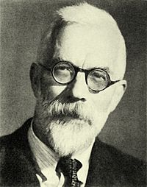
F test ANOVA
More than 1 factor more than 2 groups (NO)
R A Fisher-creator of F test statistics
https://www.youtube.com/watch?v=p3xb11Bf5lM
Monty Python Silly Olympics Games
https://www.youtube.com/watch?v=rvkrqt0r7j4
The Struggles of Having No Sense of Direction

Slide 16
references
Monty Python Silly Olympics Games,
https://www.youtube.com/watch?v=p3xb11Bf5lM , revised on November 10, 2016
Statistics for People Who (think they) Hate Statistics, Salkind, N. J., Using Microsoft Excel 2016, 4th Edition, copyright 2017, Sage Publication, Thousand Oaks, California, revised on November 10, 2016
T Test Independent Samples Definition and Examples, http://www.docs.statwing.com/examples-and-definitions/t-test/, revised on November 10, 2016
The Struggles of Having No Sense of Direction
https://www.youtube.com/watch?v=rvkrqt0r7j4, revised on November 10, 2016

